Slide 1
Lab 2 Tsagan Garyaeva
#6
SELECT vendor_name, vendor_contact_last_name, vendor_contact_first_name
from vendors
ORDER BY CONCAT (vendor_contact_last_name, vendor_contact_first_name);
#7
SELECT CONCAT(vendor_contact_first_name,', ' ,vendor_contact_last_name) AS full_name
FROM vendors
WHERE vendor_contact_last_name REGEXP '^A' OR vendor_contact_last_name REGEXP '^B' OR
vendor_contact_last_name REGEXP '^C' OR
vendor_contact_last_name REGEXP'^E';
#8
SELECT invoice_due_date AS "Due Date",
invoice_total AS "Invoice Total",
invoice_total / 10 AS "10%",
invoice_total * 1.1 AS "Plus 10%"
FROM invoices WHERE invoice_total >= 500
AND invoice_total <= 1000
ORDER BY invoice_due_date DESC;
#9
SELECT invoice_number,
invoice_total ,
payment_total + credit_total AS payment_credit_total,
(invoice_total - payment_total- credit_total)>50 AS balance_due
FROM invoices
ORDER BY balance_due
DESC LIMIT 0,5;
#10
SELECT invoice_number,
invoice_date ,
invoice_total - payment_total - credit_total AS balance_due,
payment_date
FROM invoices
WHERE payment_date IS NULL ;
#11
SELECT
CURRENT_DATE() AS " CURRENT_DATE";
#12
SELECT starting_principal, interest ,
starting_principal / POWER (1 + 0.65, 12) AS principal_plus_interest;

Slide 2
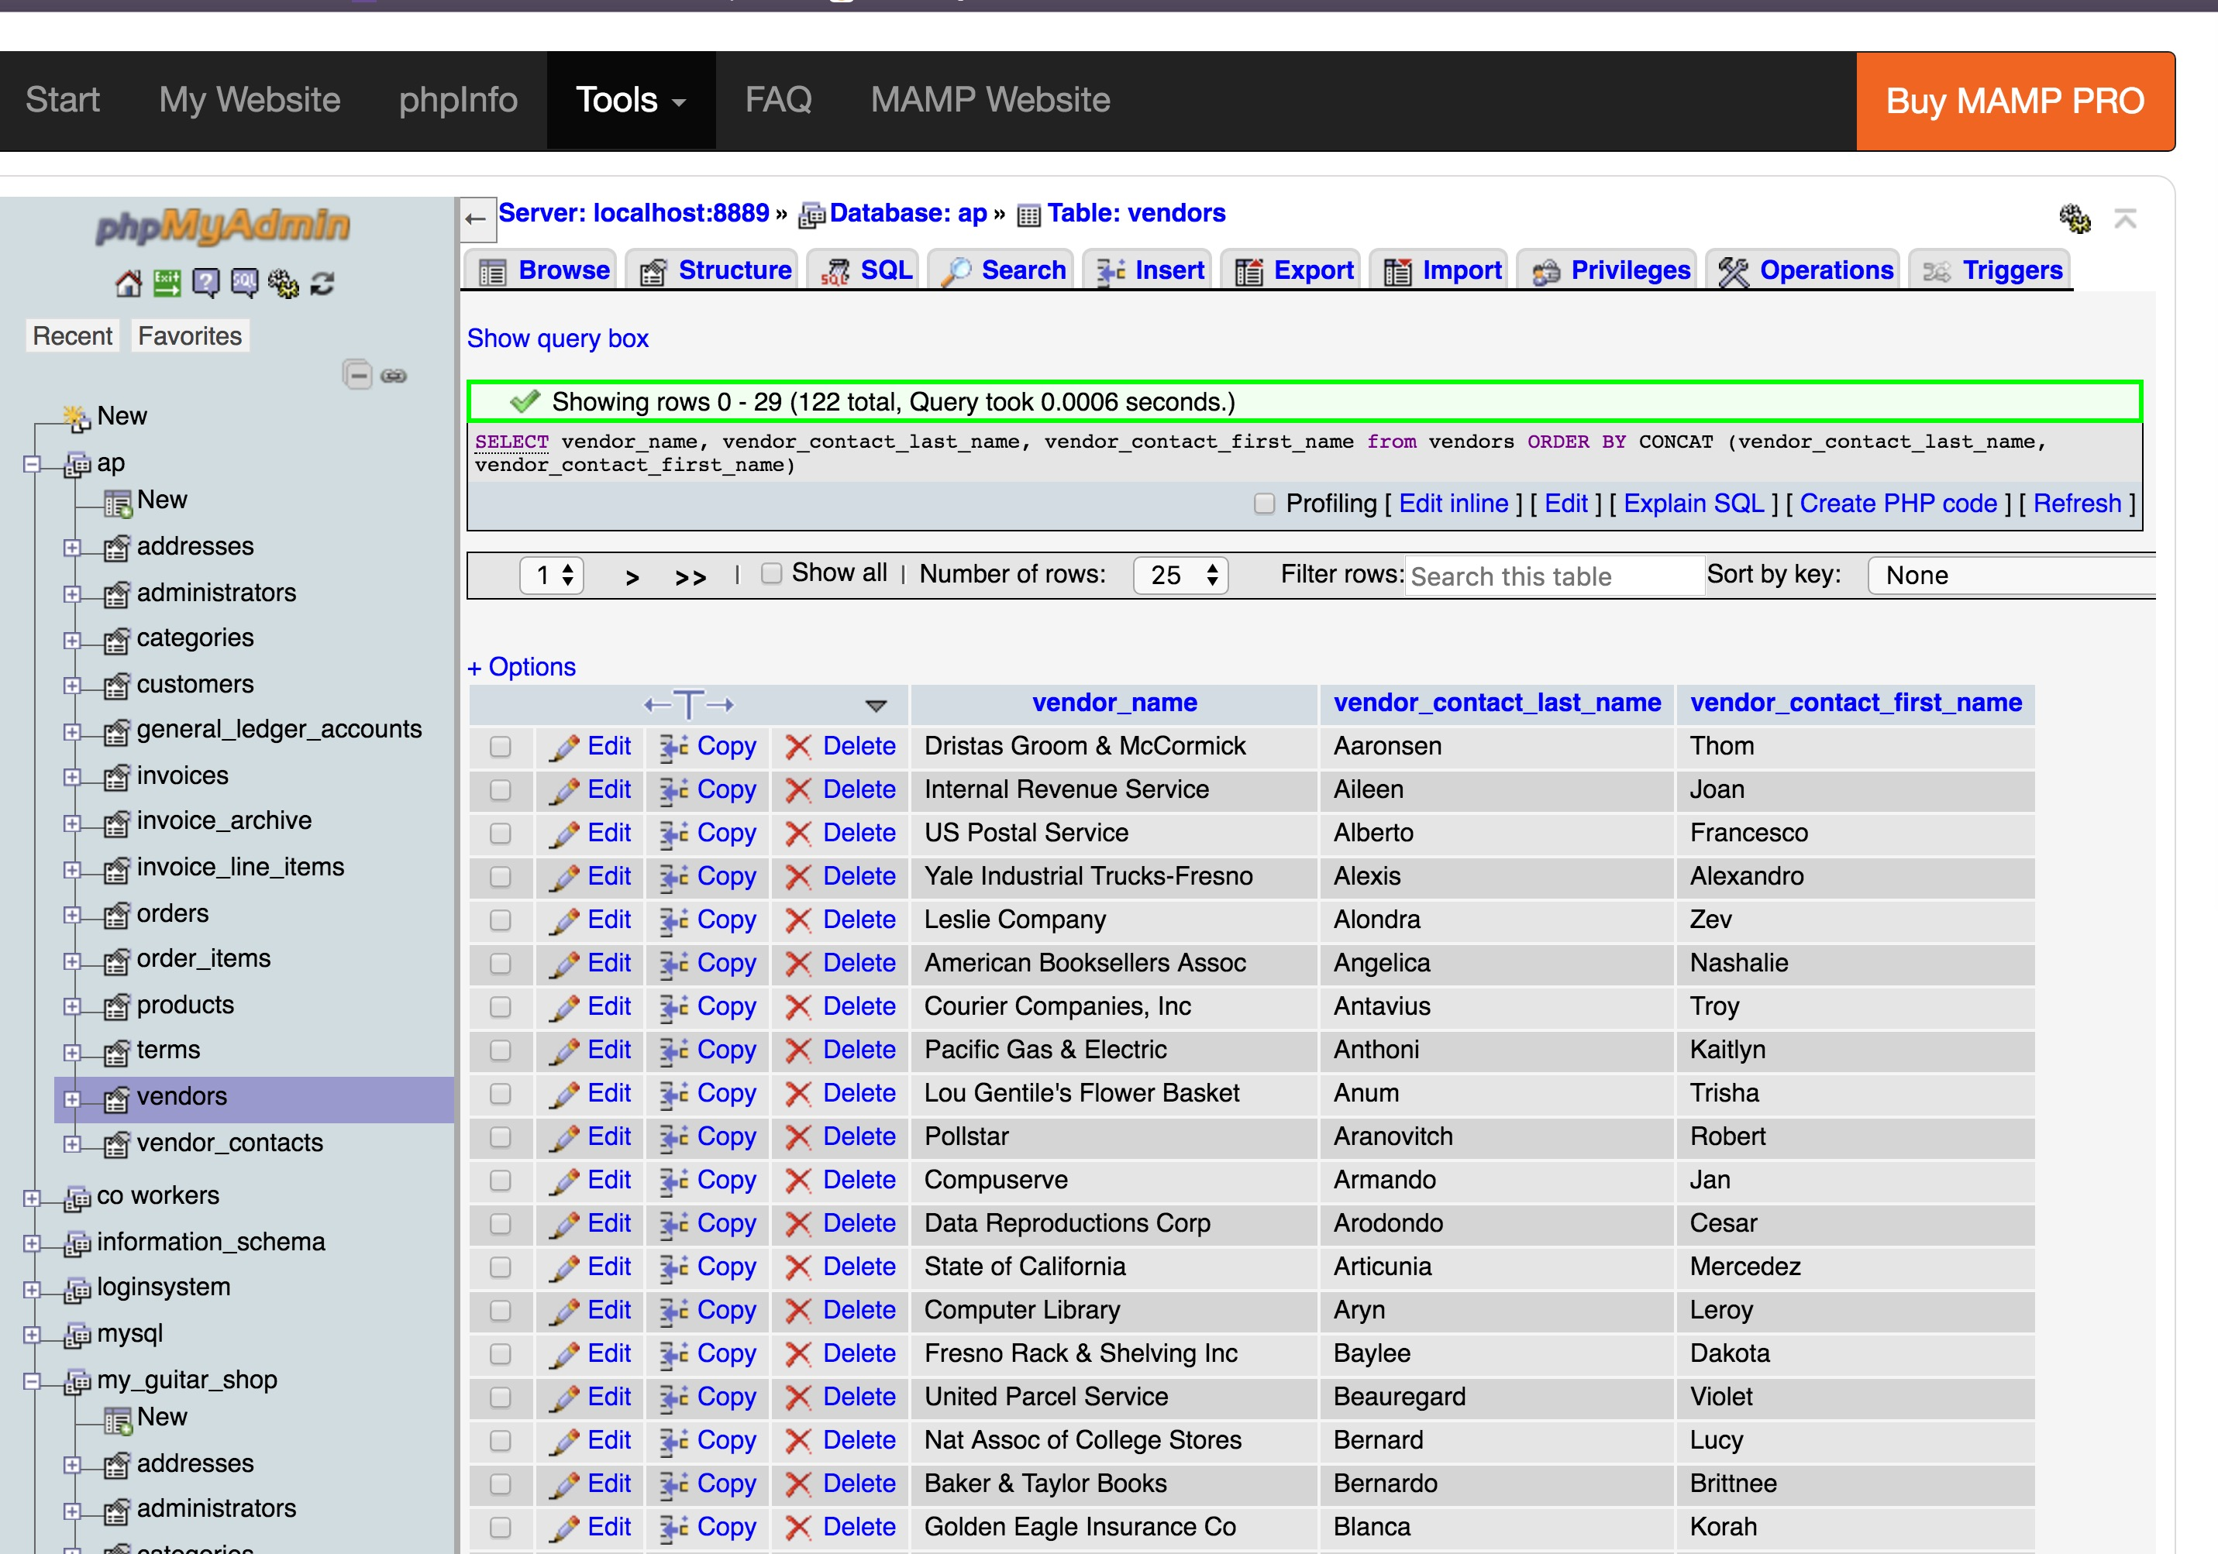

Slide 3
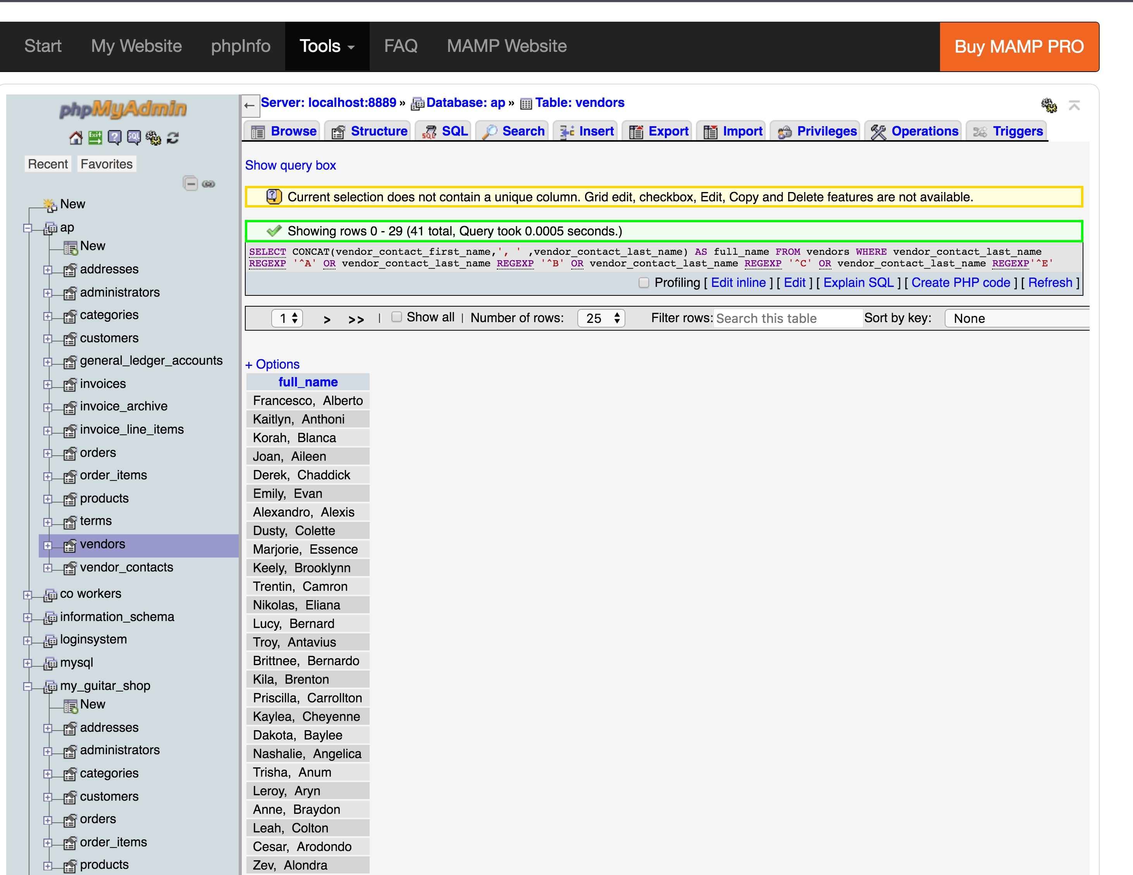

Slide 4
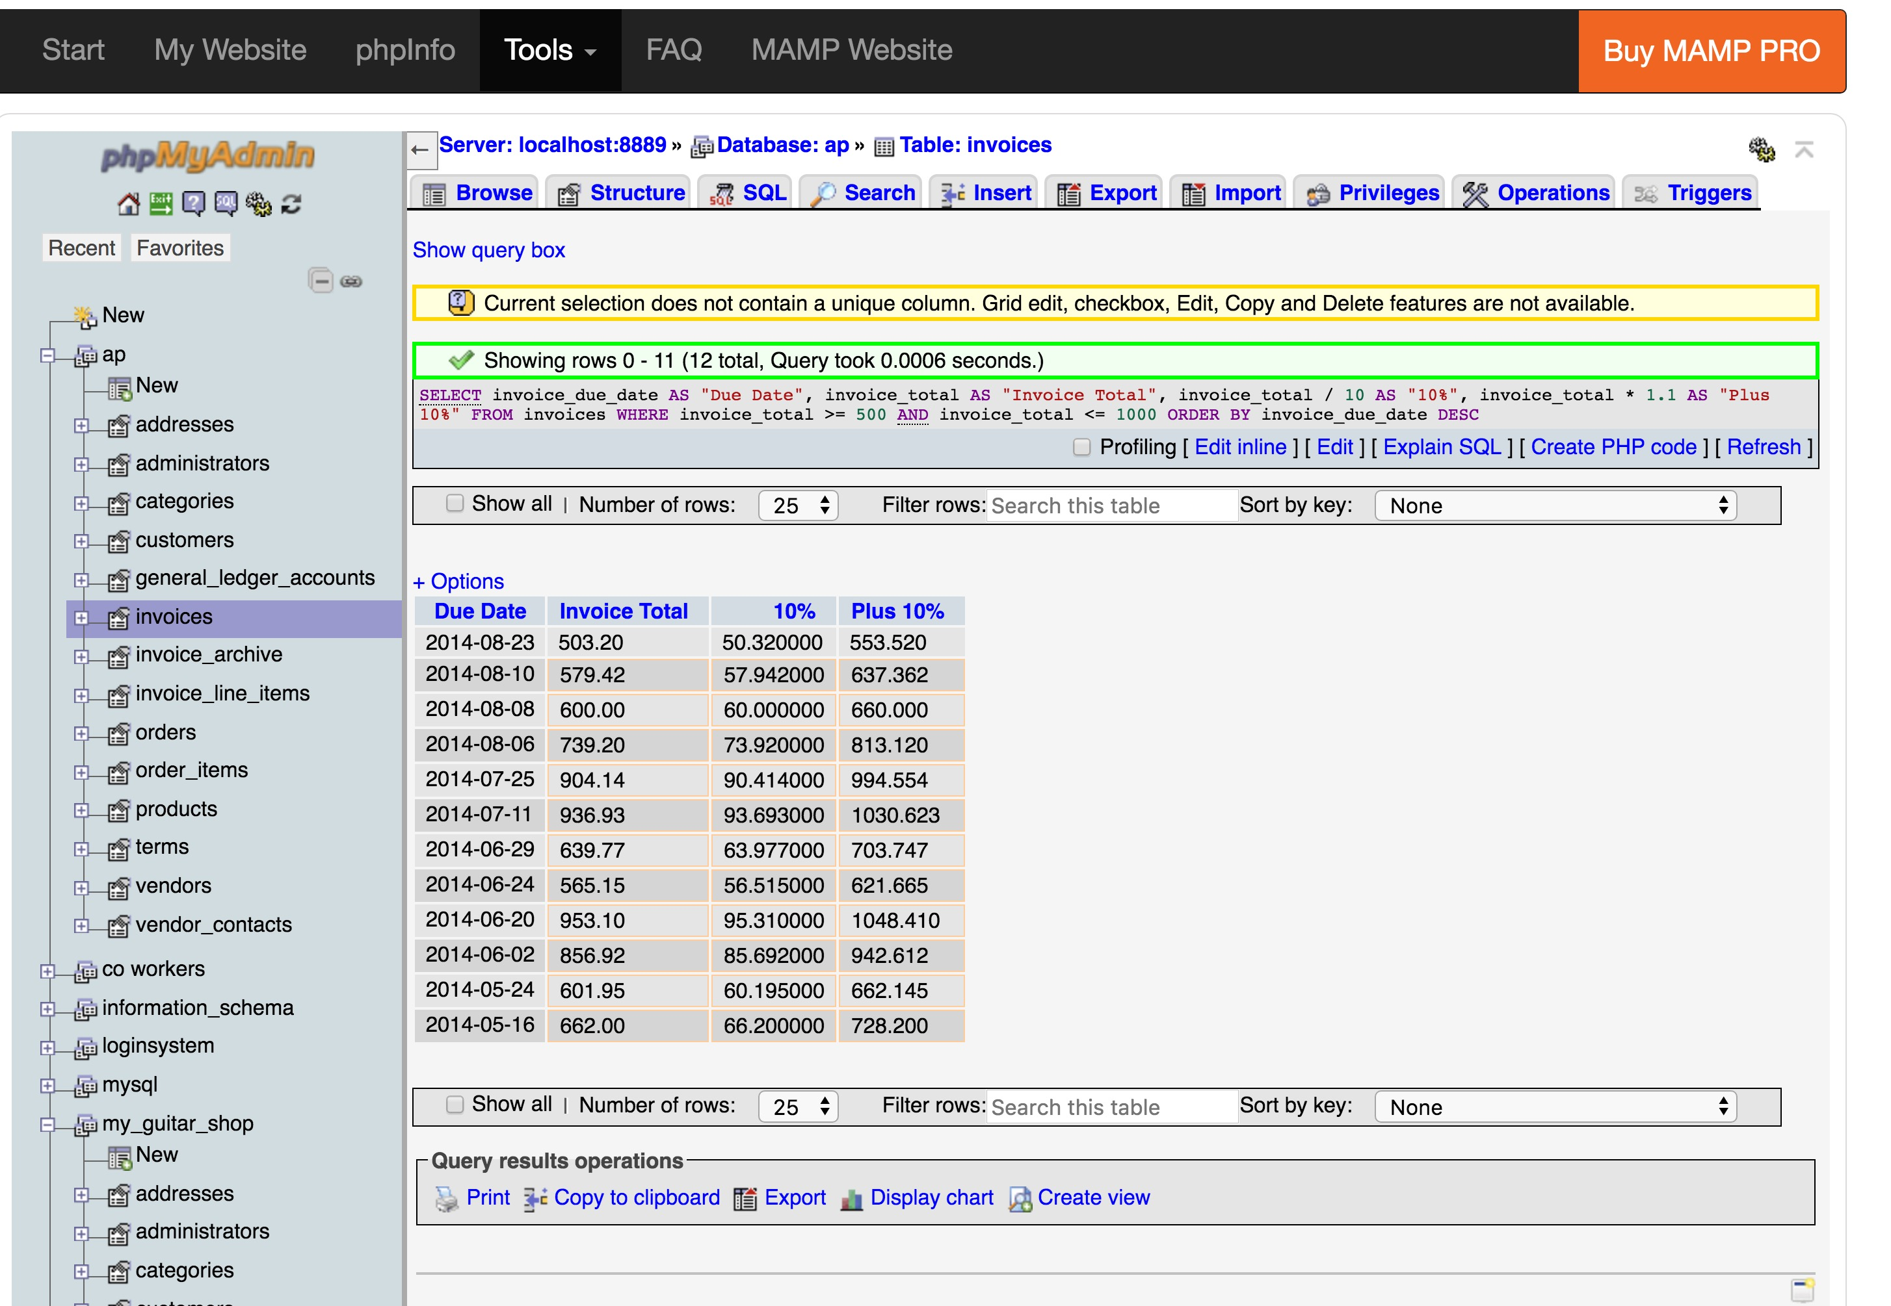

Slide 5
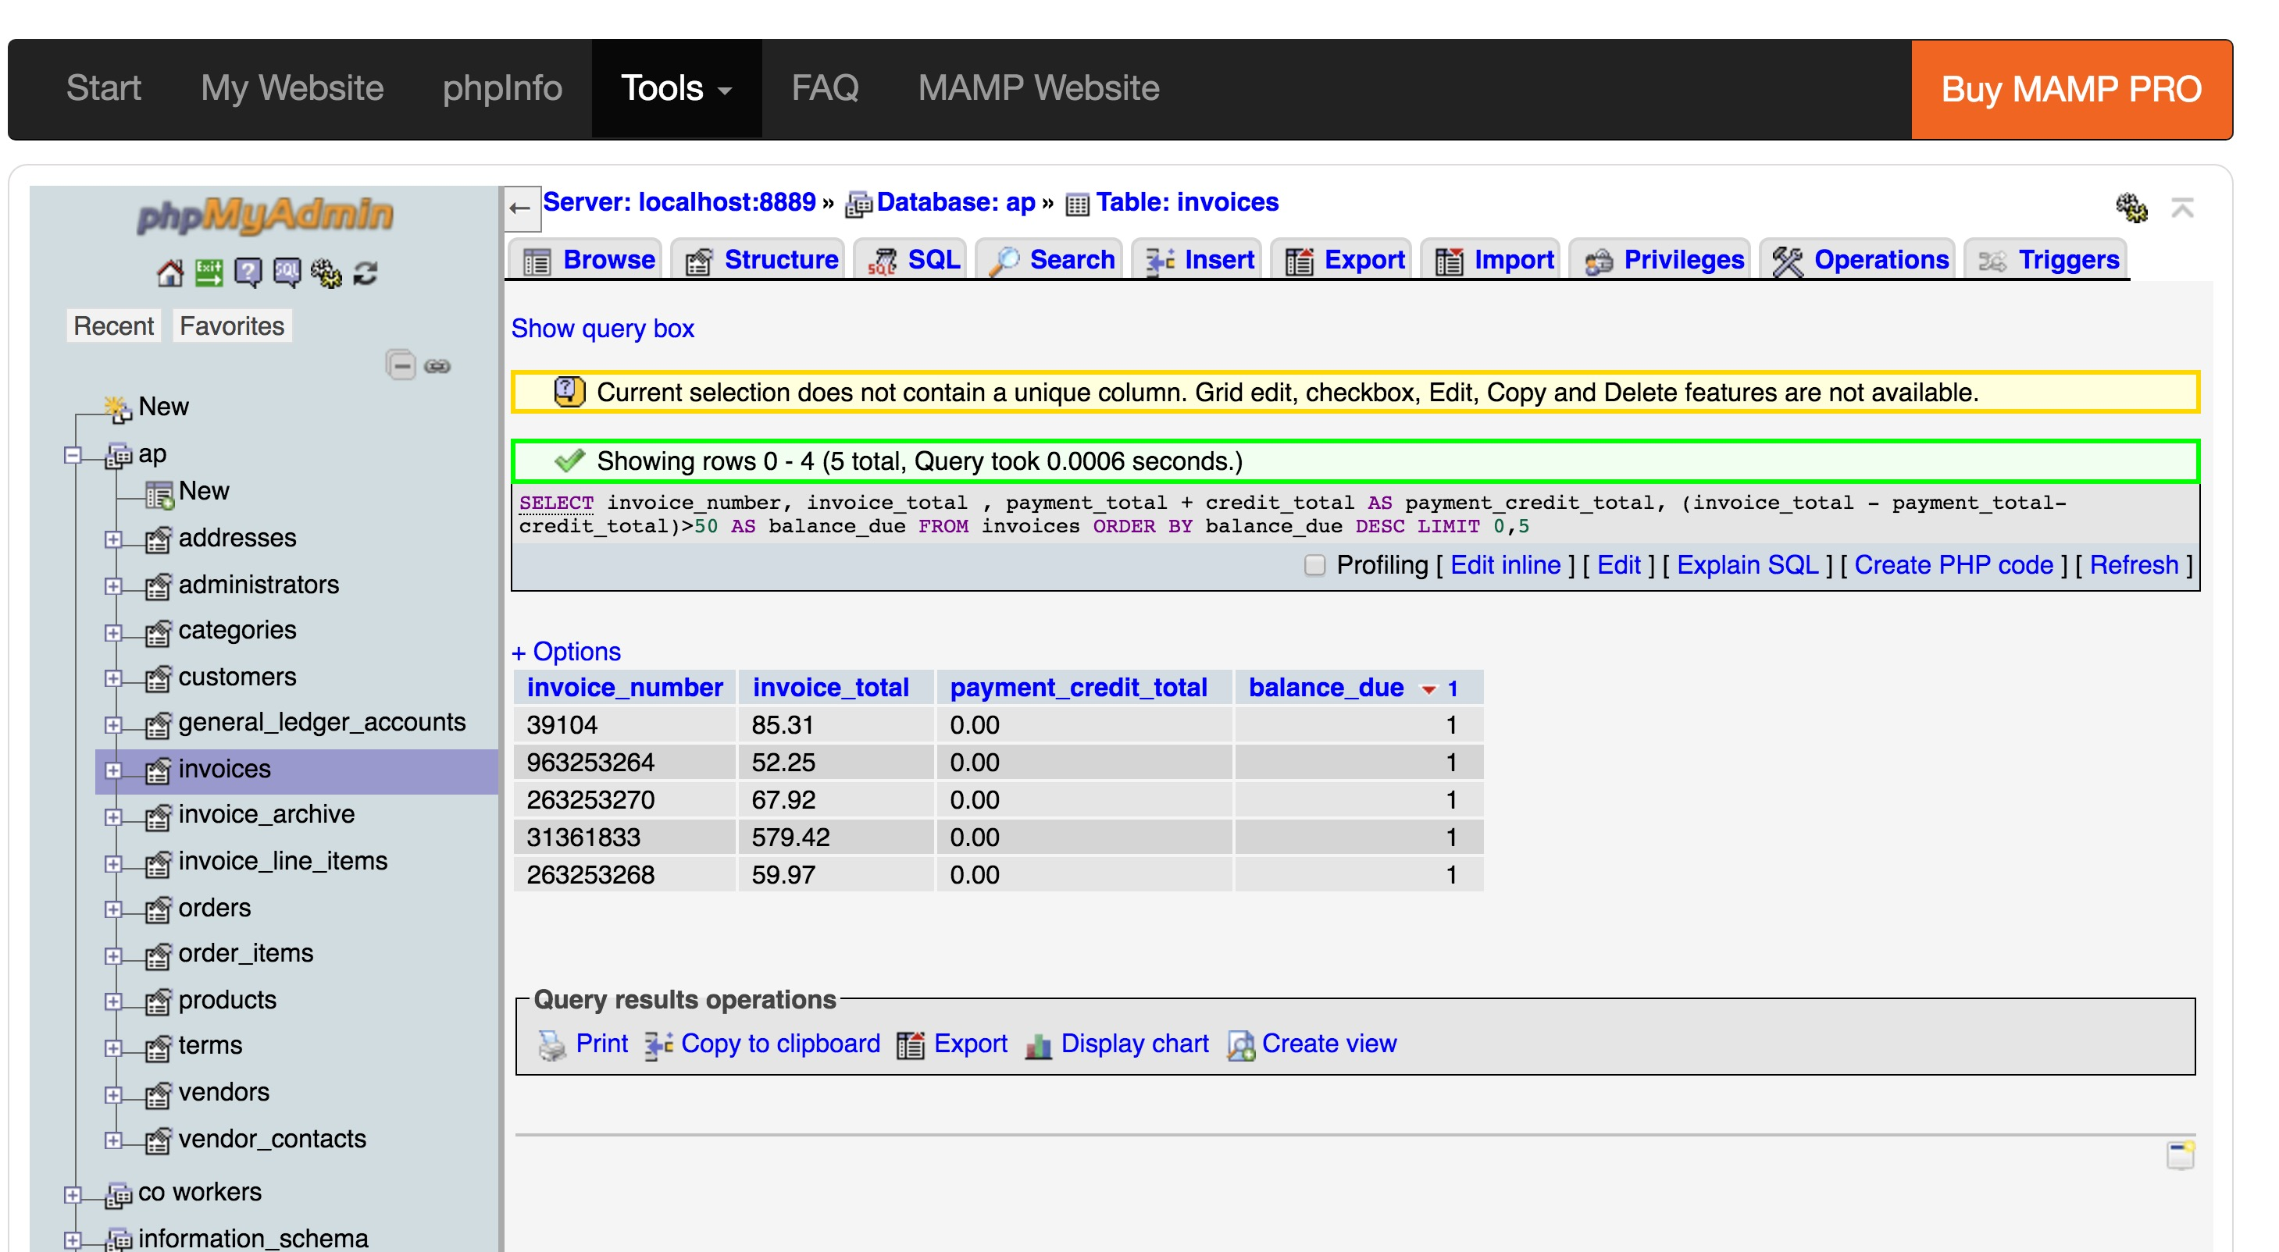

Slide 6
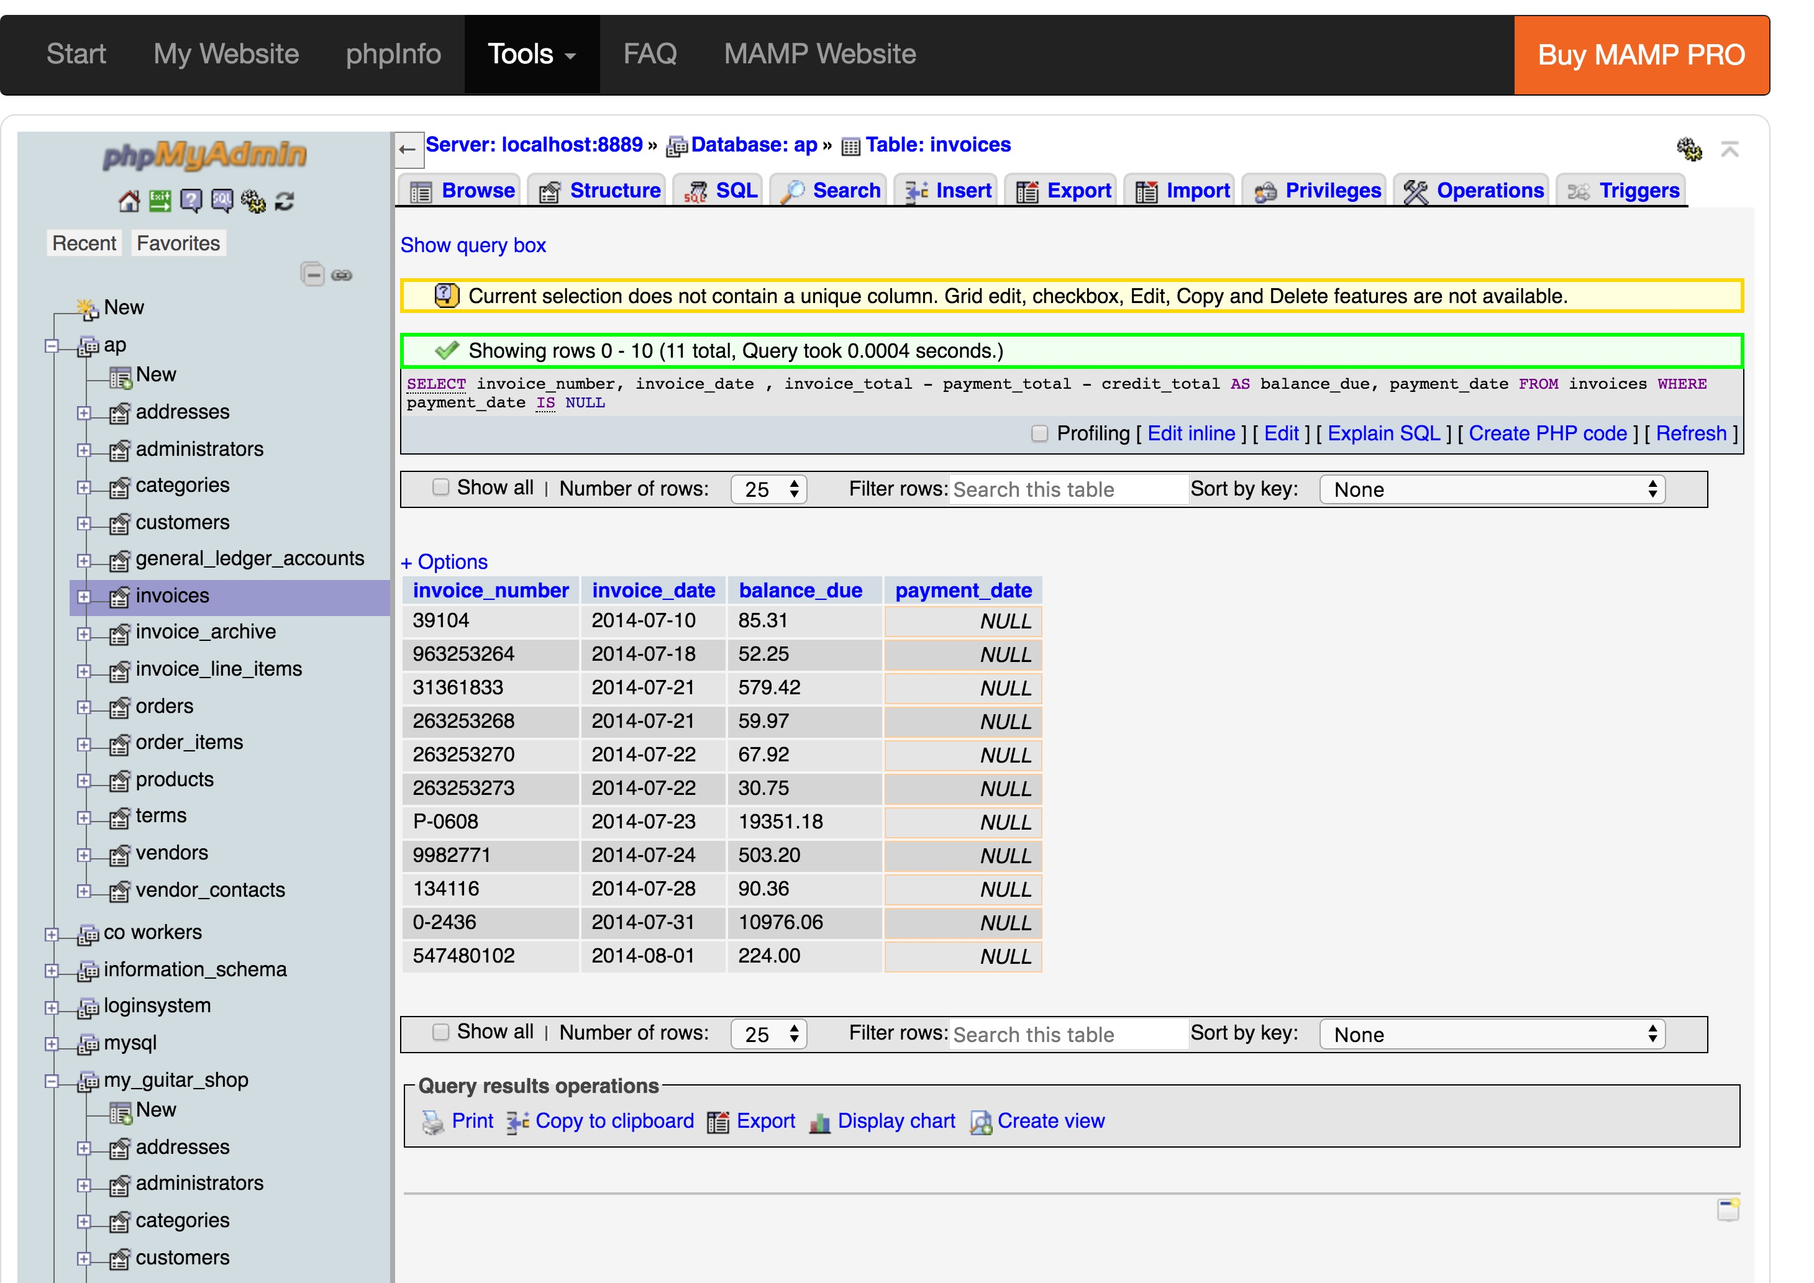

Slide 7
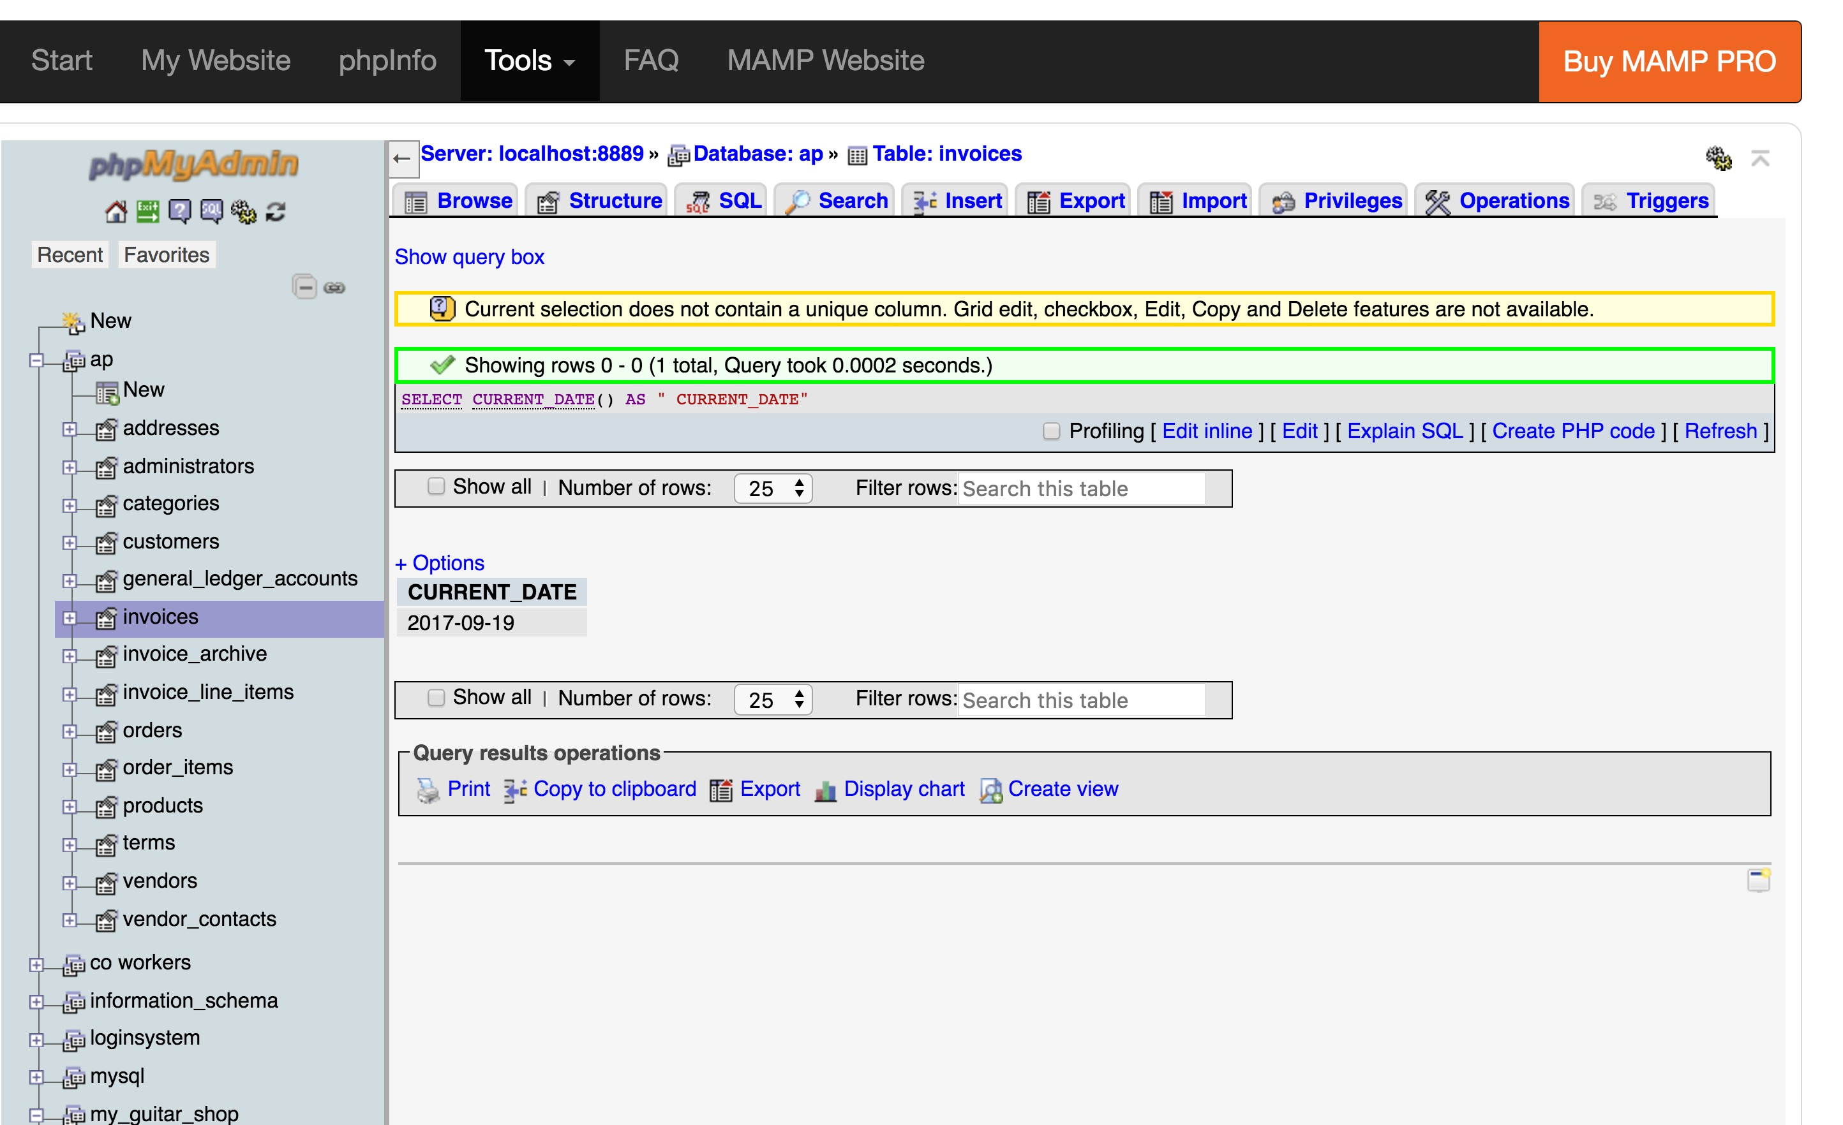

Slide 8
